Slide 1

Department of Computer Science and Engineering
Enhanced Classification and Detection of Brain Tumor using Hybrid Deep Learning and Machine Learning Models
PRESENTED BY
Bala Sri Abhigna Divvela 21471A0519
Sameera Shaik 21471A0555
Harini Chinnam 21471A0516
Under the Guidance of,
DR. SIREESHA MOTURI _{M.Tech., Ph.D.}
Assistant Professor,
Department of Computer Science and Engineering,
Narasaraopeta Engineering College (Autonomous),
Narasaraopet- 522 601.

Slide 2
OUTLINE
Abstract
Introduction
Literature Survey
Research Gaps
Problem Statement
Objectives
Block Diagram / Flow Diagram
Methodology
Implementation
Results and Analysis
Conclusion & Future Scope
References
Question and Answers
Acknowledgements

Slide 3
ABSTRACT
Brain tumors, caused by abnormal brain cell growth, significantly impact quality of life and life expectancy. MRI scans are the primary diagnostic tool, but manual identification is labor-intensive and relies on radiologists' expertise. To address this, a deep learning and machine learning-based approach is proposed for tumor detection. MRI images are enhanced using Adaptive Contrast Enhancement Algorithm (ACEA) and median filtering, while tumor segmentation is performed with the fuzzy c-means algorithm. Key features such as energy, mean, entropy, and contrast are extracted using the Gray-level Co-occurrence Matrix (GLCM). The Ensemble Deep Neural Support Vector Machine (CNN-SVM) classifier is then used for classification, achieving 97.94% accuracy, 92% sensitivity, and 98% specificity.

Slide 4
INTRODUCTION
Brief introduction to the project
There is a growing demand for early and accurate brain tumor diagnosis, especially in countries like India, where cases are increasing. MRI scans are the most effective and non-invasive method for detecting brain tumors, but manual interpretation can be slow and inconsistent. To address this, the article proposes a hybrid model combining Convolutional Neural Networks (CNN) and Support Vector Machine (SVM) technologies.
CNN helps automatically extract features from MRI scans. SVM improves the classification of complex data. Thus, the incorporation of these two techniques is aimed at improving detection and classification of brain tumors.

Slide 5
The model uses advanced preprocessing techniques like Adaptive Contrast Enhancement Algorithm (ACEA), adaptive gamma correction, and Fuzzy C-Means (FCM) segmentation. These methods improve image quality and accurately outline the tumor, helping with better feature extraction and classification.
Importance and Relevance:
CNN-SVM helps in detecting and classifying brain tumors efficiently, leading to timely treatment and better patient outcomes.
This approach automates MRI analysis, assisting doctors in making better decisions and saving lives.
CNN extracts important features from MRI scans, while SVM ensures precise classification, reducing errors and improving accuracy.

Slide 6
LITERATURE SURVEY
No | Title | Authors | Journal Name & Year | Methodology Adapted | Key Findings | Gaps
1 | Effective Prediction of Brain Tumor Using Machine Learning Algorithms | Vikkurty, S., Hegde, N. P., Vinay Kumar, S., Recherla, A., & Ganapa, M. | Springer Nature Singapore, February 2024 | Machine learning algorithms applied to preprocessed brain tumor datasets | Achieved efficient and accurate brain tumor predictions | Limited validation on diverse datasets and real-world applicability
2 | Brain Tumor Detection Using Statistical and Machine Learning Method | Amin, J., Sharif, M., Raza, M., Saba, T., & Anjum, M. A. | Computer Methods and Programs, 2019 | Combined statistical methods and machine learning for detection | Achieved significant accuracy in brain tumor detection | Limited focus on deep learning advancements and scalability

Slide 7
No | Title | Authors | Journal Name & Year | Methodology Adapted | Key Findings | Gaps
3 | BrainTumor Classification Using Deep Learning Models | Sudha S Tuppad, Vidya S Handur, Vishwanath P Baligar | IEEEXplore 2024 Second International Conference on Advances in Information Technology (ICAIT) | Used Deep Learning models like CNNs, VGG16,andResNet50 Preprocessing MRI images, | ResNet50 achieved 99.91% accuracy in classifying Meningioma and Pituitary tumors | - Needs validation for other tumor types like glioma - Requires further testing on diverse datasets
4 | Detection of Arrhythmia Using Convolutional Neural Networks | Greeshma, B., Sireesha, M., Thirumala Rao, S. N | Springer Nature Second International Conference on Sustainable Expert Systems: ICSES 2021, February 2022 | Developed a CNN based model for arrhythmia detection. Used ECG signal preprocessing to remove noise | Demonstrated high accuracy in detecting various arrhythmia types | Lack of comparison with other advanced deep learning techniques
5 | MRI-based Brain Tumor Detection Using Convolutional Deep Learning Methods and Chosen Machine Learning Techniques | Saeedi, S., Rezayi, S., Keshavarz, H., & R. Niakan Kalhori, S. | BMC Medical Informatics and Decision Making, 2023 | CNNs with machine learning techniques and feature selection on preprocessed MRI data | High accuracy in tumor detection across datasets | Limited clinical testing and computational efficiency validation

Slide 8
LITERATURE SURVEY
The Studies Models like ResNet-100, VGGNet, and EfficientNet are leveraged to handle limited datasets and improve accuracy by 5-10%.
Previous works discussed CNN-based approaches, transfer learning models (e.g., ResNet, VGGNet), and multimodal fusion techniques for MRI analysis. Challenges identified include optimization for limited datasets and trade-offs in computational power requirements.
The CNN-SVM hybrid model is a promising approach for early brain tumor detection, leveraging preprocessing, segmentation, and machine learning for accurate and automated diagnosis.

Slide 9
RESEARCH GAPS
Dataset Diversity and Real-World Generalizability: Most studies rely on limited datasets, lacking validation on diverse and real-world data to ensure broad applicability. Models often struggle with underrepresented tumor types and fail to effectively handle class imbalances in datasets.
Handling Noise and Variability: Tumor detection models often underperform in the presence of noise, variations in image acquisition settings, and artifacts in MRI images.
Real-Time and Clinical Integration Challenges: Few models are optimized for real-time performance or practical implementation in clinical workflows, including challenges in interpreting model outputs by medical professionals.
Evaluation Metrics: Research often focuses on accuracy, neglecting comprehensive evaluations such as robustness, false-positive/negative rates, and usability in borderline cases.

Slide 10
PROBLEM STATEMENT
The research focuses on the timely and accurate detection of brain tumors using MRI, as brain tumors are among the most serious cancers. In India, around 40,000 new cases are reported annually, making early detection crucial for improving survival rates. Accurate classification of tumors like gliomas, meningiomas, and pituitary tumors is essential for proper treatment, as misdiagnosis can lead to inadequate care and severe complications. Traditional diagnostic methods rely on manual MRI analysis, which can be time-consuming and prone to errors.
To overcome these challenges, automated systems like the hybrid CNN-SVM model offer a reliable solution by enhancing diagnostic accuracy and speed, assisting healthcare professionals in making more informed decisions. The CNN extracts critical features from MRI scans, while SVM provides precise classification, ensuring better generalization and reduced misclassification. With advancements in deep learning and machine learning, integrating these technologies in medical imaging can significantly improve early detection, optimize treatment strategies, and ultimately enhance patient outcomes.

Slide 11
OBJECTIVES
Development of a Hybrid Model: The primary objective is to create a hybrid model that integrates Convolutional Neural Networks (CNNs) for effective feature extraction and Support Vector Machines (SVMs) for high-precision classification of brain tumors in MRI images.
Enhance MRI Image Processing: Apply advanced preprocessing techniques such as Adaptive Gamma Correction and Fuzzy C-Means clustering to improve the clarity, segmentation, and feature extraction of MRI images..
Improve Classification Accuracy: Achieve high accuracy, sensitivity, and specificity in distinguishing between normal brain tissue and various types of tumors, such as glioma, meningioma, and pituitary tumors.
Validate Model Performance :Compare the proposed CNN-SVM hybrid model with existing methodologies (e.g., CNN, VGG, RNN) using metrics like accuracy, sensitivity, specificity, and Jaccard Index.
Enhancing Diagnostic Efficiency: The ultimate goal is to provide an automated approach for early diagnosis of brain tumors, thereby improving treatment outcomes and reducing the workload on healthcare professionals.

Slide 12
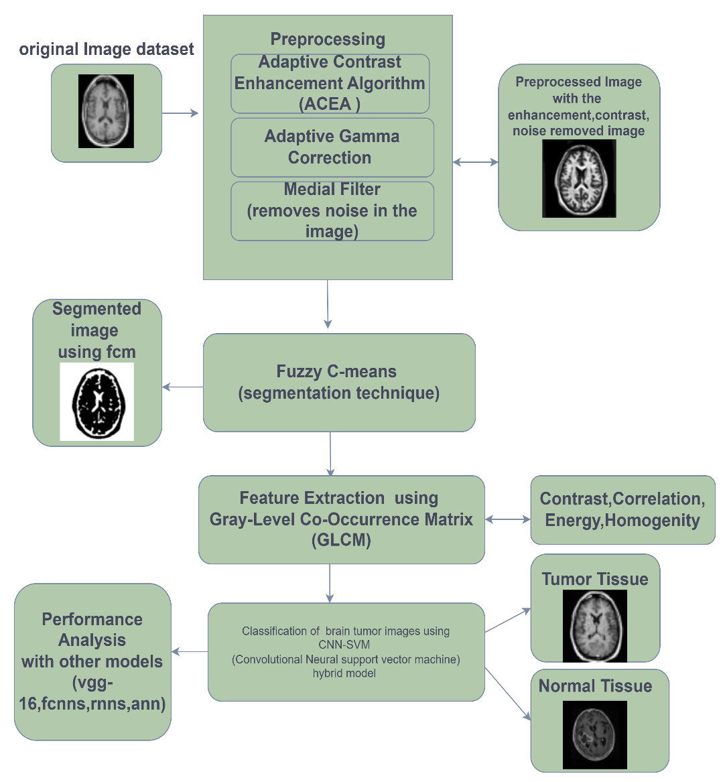
BLOCK DIAGRAM OR FLOW DIAGRAM
Data Set : A Kaggle dataset is used that involves T1-sequenced enhanced MRI scans of subjects with brain tumors. Different tumor types are all included in the same dataset which has a meningioma, glioma, pituitary and an absent tumor images.
Preprocessing and Extraction : This involves enhancing contrast to make features clearer (using ACEA), adjusting brightness and contrast based on the images, and removing noise while keeping important edges sharp. Analyze the texture of these regions to find patterns using FCM.
Classify (Tumor or No Tumor): A hybrid of CNN and SVM is used for classification.

Slide 13
METHODOLOGY
Data Set Collection
The dataset is substantial, containing 3064 individual MRI images. This relatively large size is important for training robust machine learning models, as it provides a diverse range of examples for the model to learn from.
Four categories: Glioma, Meningioma, Pituitary, and No Tumor (healthy brain).
Class Distribution: Glioma: 1426 images, Meningioma :708 images, Pituitary 930 images , No Tumor : 804 images.
T1-weighted contrast-enhanced MRI (a specific type of MRI scan that highlights tumors).
Feature | Details
Total Images | 3064
Total Patients | 233
Tumor Classes | Glioma, Meningioma, Pituitary, No Tumor
Class Distribution | Glioma: 1426, Meningioma: 708, Pituitary: 930, No Tumor: 804
Image Type | T1-weighted contrast-enhanced MRI
Applications | Tumor classification and detection
Fig : Data Set Description

Slide 14
Pre-Processing Steps
Pre-processing transforms raw data into a clean, structured format suitable for deep learning models. It ensures data is properly formatted for different algorithms, improving model performance. As the first step in deep learning, preprocessing is essential for accurate analysis and better results. During this preprocessing, images undergo several preprocessing methods applied to MRI images to enhance their quality and ensure accurate brain tumor classification. These methods are as follows:
Adaptive Contrast Enhancement (ACE): Enhances image contrast by calculating local statistics like mean pixel intensity and standard deviation.
Adaptive Gamma Correction : Dynamically adjusts brightness and contrast in different image regions for better visualization of tumors.

Slide 15
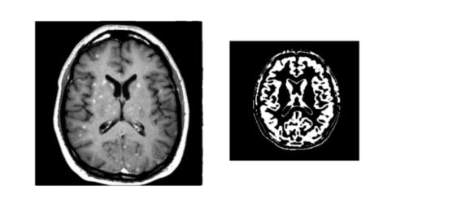
Median Filtering: Median filtering reduces noise in MRI images while preserving edges and fine structures. It replaces each pixel with the median of its surrounding values, effectively removing speckle and salt-and-pepper noise while maintaining tumor details.
Fuzzy C-Means (FCM) Segmentation: FCM helps identify tumor areas in MRI images by grouping pixels with similar brightness. Unlike basic methods, it allows pixels to belong to multiple regions, making it more accurate in detecting tumors with uneven brightness and blending.
Fig 6.3 Image after applying the preprocessing technique.

Slide 16
Feature Extraction using GLCM:
The Gray Level Co-occurrence Matrix (GLCM) is a matrix that describes the frequency of pixel pairs with specific values in a specified spatial relationship, typically focusing on pairs of pixels separated by a certain distance in a particular direction. The main idea is to quantify the spatial patterns of pixel intensities in an image, which are often associated with different tissue types, such as healthy tissue, tumor regions, and surrounding structures in MRI scans.
Key Features Extracted from GLCM:
Contrast
Correlation
Energy
Homogeneity

Slide 17
Model building using ML and DL methods
The CNN-SVM hybrid model is a powerful computational approach for detecting and classifying brain tumors from MRI images. This model leverages the strengths of Convolutional Neural Networks (CNNs) for feature extraction and Support Vector Machines (SVMs) for precise classification, achieving high accuracy and reliability in medical imaging.
Convolutional Neural Networks
A Convolutional Neural Network (CNN) is a type of deep learning model particularly well-suited for processing structured data such as images. CNNs automatically and adaptively learn spatial hierarchies of features from input data through the use of convolutional filters, pooling, and fully connected layers.

Slide 18
Layers in CNN:
Input Layer
Convolutional Layer
Activation Layer
Pooling Layer
Flattening Layer
Fully Connected Layer (Dense Layer)
Output Layer
Support Vector Machine (SVM)
The Support Vector Machine is a supervised machine learning algorithm designed for classification and regression tasks. It works by identifying the optimal decision boundary, known as a hyperplane, which separates data points belonging to different classes. The SVM aims to maximize the margin, which is the distance between the hyperplane and the closest data points from each class.
SVM is effective in high-dimensional spaces and works well with small datasets due to its robustness against overfitting. However, it can be computationally intensive for large datasets, and its performance heavily depends on the choice of kernel and hyperparameters. Despite these challenges, is widely used in applications such as text classification, image recognition, and bioinformatics for its ability to provide accurate and reliable results.

Slide 19
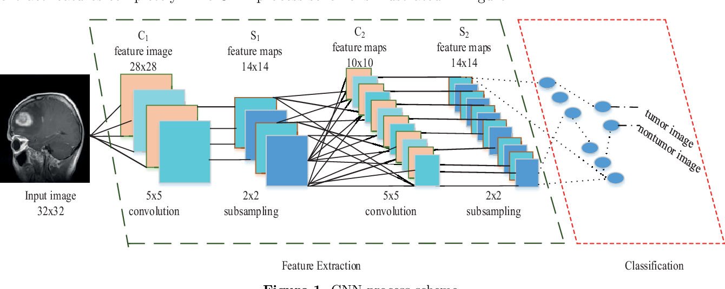
IMPLEMENTATION
Hybrid CNN-SVM Model
This system detects tumors in MRI images using a combination of a Convolutional Neural Network (CNN) and a Support Vector Machine (SVM). First, the MRI images are preprocessed to enhance their quality. Then, a CNN analyzes these images, automatically extracting key features like edges, textures, and patterns, effectively simplifying the image data. This simplified data is then passed to an SVM, which classifies it to determine whether a tumor is present.
The system is trained in two stages: the CNN is trained first to learn effective features, and then the SVM is trained using those extracted features. This approach combines the CNN's powerful ability to learn complex image patterns with the SVM's accuracy in classifying data.
Fig CNN-SVM Architecture

Slide 20
IMPLEMENTATION
Software Specifications:
Programming Language: Python
Libraries Used: TensorFlow, Keras, Scikit-learn, NLTK for preprocessing, and Matplotlib for visualizations.
Data Storage: ISEAR dataset in CSV format processed using Pandas.
Development Environment: Google Colab for model training and testing.
Hardware Specifications:
System: NVIDIA GPU-enabled machine for accelerated training.
Processor: Intel Core i7 or equivalent.
RAM: Minimum 16GB for handling dataset and model complexity.
Storage: SSD for faster data access and storage.

Slide 21
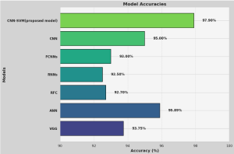
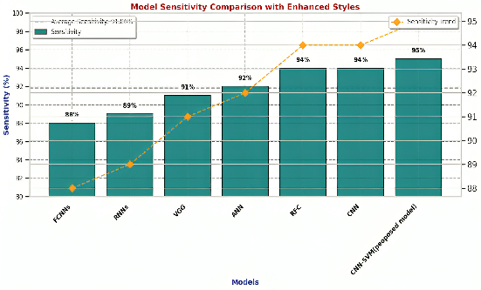
RESULTS & ANALYSIS
Evaluation Metrices:
The evaluation of models compared CNN-SVM model with other models such as CNN, VGG, RNN, RFC, FCNN and ANN. Accuracy, Jaccard index as well as sensitivity are used to measure performance.
Accuracy: Measures the overall correctness of the model in identifying both tumor and non-tumor cases.
Sensitivity: Indicates the model's ability to correctly identify actual tumor cases, showing the proportion of true positives among all actual positives
Fig :Accuracy and Sensitivity Comparison

Slide 22
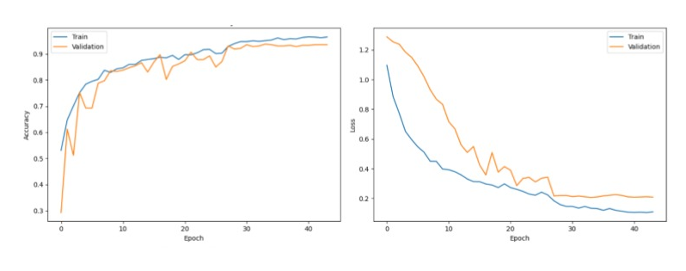
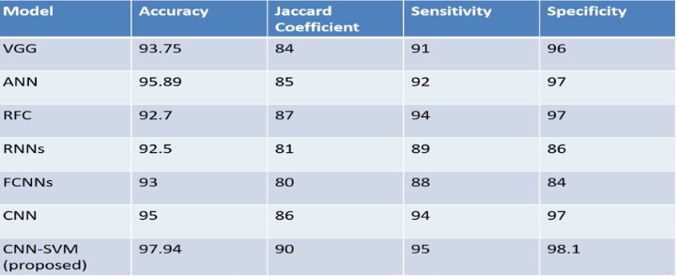
RESULTS & ANALYSIS
The study compared models like CNN, ANN, RFC, RNN, FCNN, and VGG with the proposed CNN-SVM hybrid. While ANN and RFC are accurate but computationally demanding, and RNNs work well with sequential data but are also processing-heavy, the CNN-SVM hybrid offers both high accuracy and efficiency. Results confirmed that CNN-SVM reliably performs quick brain tumor detection. And gives more accuracy compared to other models.

Slide 23
CONCLUSION
The hybrid CNN-SVM model demonstrates a breakthrough in the detection of tumors in the brain as it integrates the advantageous aspects of feature extraction using the CNN and classification using SVM. Such combination leads to the development of a model that is superior to more conventional methods, over ANN, RFC, and simple CNN models, in factor performance evaluation especially in terms of accuracy, sensitivity, specificity and the Jaccard index. The CNN-SVM model, on the other hand, recorded a remarkable 97.94% accuracy, which showed its strength in differentiating healthy and tumor tissue in MRI scans.
The CNN-SVM hybrid is an optimal solution that is both effective and efficient, as opposed to the traditional techniques that possess problems of high computational complexity or low efficiency. The model is a suitable method for practical medical use where quick diagnosis and accuracy are required since it produces accurate results at a lower computational expense. The hybrid model of CNN-SVM is promising in aiding healthcare workers towards the accurate, precise, and rapid evaluation of brain tumors in patients as it overcomes the shortcomings of other approaches and improves diagnostic accuracy thereby enhancing patient care and outcomes

Slide 24
Future Scope
Integration with Clinical Software: Incorporate the CNN-SVM hybrid model into clinical software systems to facilitate seamless and automated tumor detection in hospitals and diagnostic centers.
Application to Multimodal Data: Extend the model's capabilities to handle multimodal data inputs such as PET scans and CT scans alongside MRI images for comprehensive diagnostic capabilities.
Real-Time Diagnostics: Optimize the computational efficiency of the model to enable real-time brain tumor detection and classification in clinical environments.
3D Imaging and Analysis: Adapt the model to work with 3D MRI datasets, enhancing the precision and accuracy of tumor segmentation and classification.
Ethical and Regulatory Considerations: Focus on addressing ethical, privacy, and regulatory requirements to ensure the model’s adoption in clinical settings.

Slide 25
REFERENCES
Pujar, M., Kavanashree, H., Jitendra, M., Halemani, S., & Handur, V. (2024, March). Brain Tumor Detection and Classification Using Deep Learning Models. In International Conference on Power Engineering and Intelligent Systems (PEIS) (pp. 445-463). Singapore: Springer Nature Singapore
Greeshma, B., Sireesha, M., Thirumala Rao, S. N. (2022, February). Detection of arrhythmia using convolutional neural networks. In Proceedings of Second International Conference on Sustainable Expert Systems: ICSES 2021 (pp. 21-30). Singapore: Springer Nature Singapore
Saeedi, S., Rezayi, S., Keshavarz, H., & R. Niakan Kalhori, S. (2023). MRI-based brain tumor detection using convolutional deep learning methods and chosen machine learning techniques. BMC Medical Informatics and Decision Making, 23(1), 16.
Vikkurty, S., Hegde, N. P., Vinay Kumar, S., Recherla, A., & Ganapa, M. (2024, February). Effective Prediction of Brain Tumor Using Machine Learning Algorithms. In International Conference on Communications and Cyber Physical Engineering 2018 (pp. 489-497). Singapore: Springer Nature Singapore.

Slide 26
H. Mohsen, E.S.A. El-Dahshan, E.S.M. El-Horbaty, A.B.M. Salem, Classification using deep learning neural networks for brain tumors, Future Computing and Informatics Journal 3 (1) (2018) 68–71.
M. Siar, M. Teshnehlab, Brain tumor detection using deep neural network and machine learning algorithm, in: 2019 9th International Conference on Computer and Knowledge Engineering (ICCKE), IEEE, 2019, October, pp. 363–368.
C.L. Choudhury, C. Mahanty, R. Kumar, B.K. Mishra, Brain tumor detection and classification using convolutional neural network and deep neural network, in: 2020 International Conference on Computer Science, Engineering and Applications (ICCSEA), IEEE, 2020, March, pp. 1–4.
M.A. Naser, M.J. Deen, Brain tumor segmentation and grading of lower-grade glioma using deep learning in MRI images, Comput. Biol. Med. 121 (2020) 103758.
J. Amin, M. Sharif, M. Yasmin, S.L. Fernandes, A distinctive approach in brain tumor detection and classification using MRI, Pattern Recogn. Lett. 139 (2020) 118–127.

Slide 27
QUESTIONS and ANSWERS
Any Questions

Slide 28
ACKNOWLEDGEMENTS
Thank you for the opportunity to present our research on the "Enhanced Classification and Detection of Brain Tumor using Hybrid Deep Learning and Machine Learning Models." We appreciate your interest in our work and are eager to contribute to advancements in brain tumor detection and diagnosis.
Bala Sri Abhigna Divvela
abhidiveela@gmail.com
Sameera Shaik
sameerashaik22498@gmail.com
Harini Chinnam
chinnamharini30@gmail.com

Slide 29
Thank You

